Slide 1

BIO103 Lab (1 credit hour) SUMMER 2025
Dept. of Biochemistry & Microbiology

Slide 2
Experiment 02
Determination of Blood Group ( Haemagglutination)

Slide 3
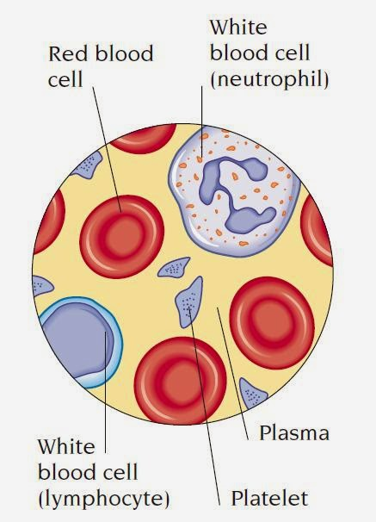
Human blood cell includes Red blood cells, White blood cells, and Platelets.
Blood groups are mainly determined by the presence or absence of Antigens on the surface of our Red blood cells or Erythrocytes.
The presence of a specific antigen is examined by the corresponding Antibody which causes Agglutination of erythrocytes.
Human blood is grouped mainly for two particular groups of antigens- ABO antigen and Rhesus (Rh) or D antigen.

Slide 4
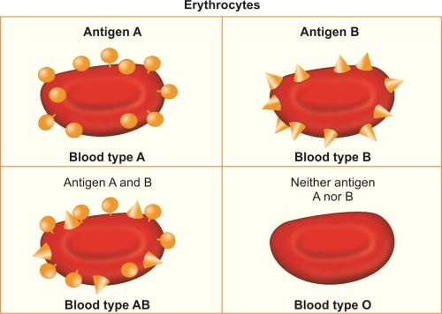
ABO Antigens
They are Carbohydrate antigens (glycoprotein) .
Two types of antigens - A, and B are presented by the red blood cells and according to their presence and absence, we’ve got four types of blood group – A, B, AB and O.

Slide 5
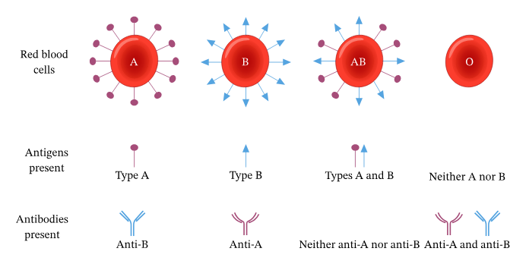
https://www.nagwa.com/en/explainers/840184795352/

Slide 6
Antibody
Antibodies are proteins found in blood plasma. They're part of our body’s natural defenses. Produced by the immune system following exposure to a foreign antigen, germs or particles.
Antibodies bind specifically to the corresponding antigen on the red cells.
Humans with A-type blood do not contain antibody against A-antigen, they possess antibody against antigen B.

Slide 7
Table: ABO Blood group
Blood type | Antigens on Erythrocytes | Antibodies in Serum
A | A | Anti-B
B | B | Anti-A
AB | A and B | Neither
O | Neither | Both Anti-A and Anti-B

Slide 8
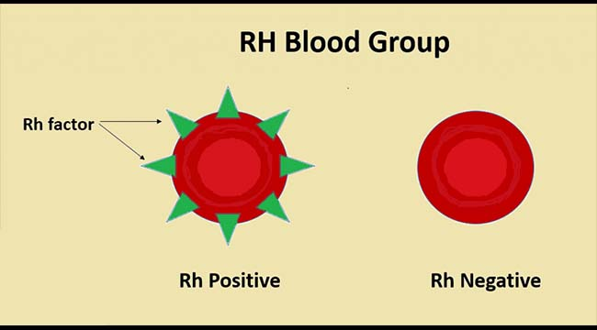
Rh Antigens
Six antigens in this group as C, c, D, d, E and e.
Type D antigen is widely prevalent in population and determiner of Rh Blood type.
Presence of D antigen = Rh Positive (+ve) Absence of D antigen = Rh Negative (-ve)

Slide 9
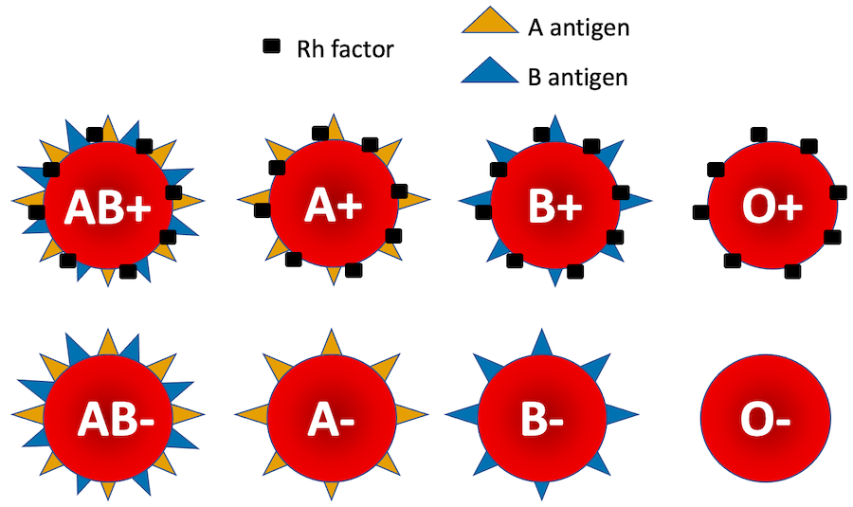
Human Blood Type

Slide 10
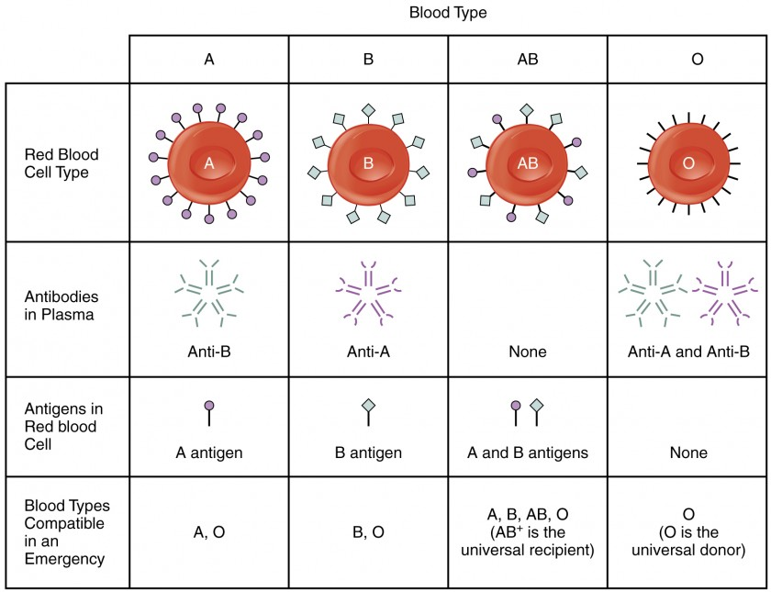
https://courses.lumenlearning.com/suny-ap2/chapter/blood-typing/

Slide 11
Determination of Blood Group : Principle
Human red blood cells possessing A and/or B antigen will agglutinate in the presence of antibody directed towards the antigen.
Agglutination of RBC with Anti-A, Anti-B and Anti-AB reagents are a positive test result and indicates the presence of the corresponding antigen..
Rho (D) antigen will agglutinate in the presence of antibody directed towards the antigen. Agglutination of RBC with spectrum Anti-D (Rho) reagents is a positive test result and indicates the presence of D (Rho) antigen.

Slide 12
Materials
Sample: Human blood (Collected from own body)
Reagents:
Reagent A (Anti-A)
Reagent B (Anti-B)
Reagent D (Anti-D)
Equipment: Clean test slide, sterile needle, tooth pick

Slide 13
Procedure
1. Mark (circle) the test slide as A, B and D to keep three blood drops distant apart
2. Collect blood from the individual using a sterile needle
3. Take blood drops on the glass slide at A, B, D marked sites
4. Add one drop of each A, B, D reagent to the blood at the corresponding sites
5. Mix the reagent well with the serum by tooth pick
6. Gently stir the slide to visualize the agglutination

Slide 14
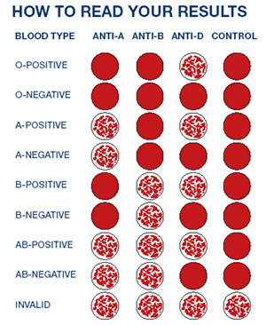

Slide 15
Importance of Blood Grouping
1. The most important reason to know your blood type is in case of emergency. If you are in a situation where you require a blood transfusion, you’ll need compatible blood. An incompatible blood group can cause blood cells to clump-which can be fatal.
2. Knowing your blood type can help predict some conditions that can occur during pregnancy, such as Rh incompatibility between mom and baby.
3. One of the best, and most selfless, reasons to know your blood type is to help others through blood donations. Medical facilities are always in need of blood donations.

Slide 16
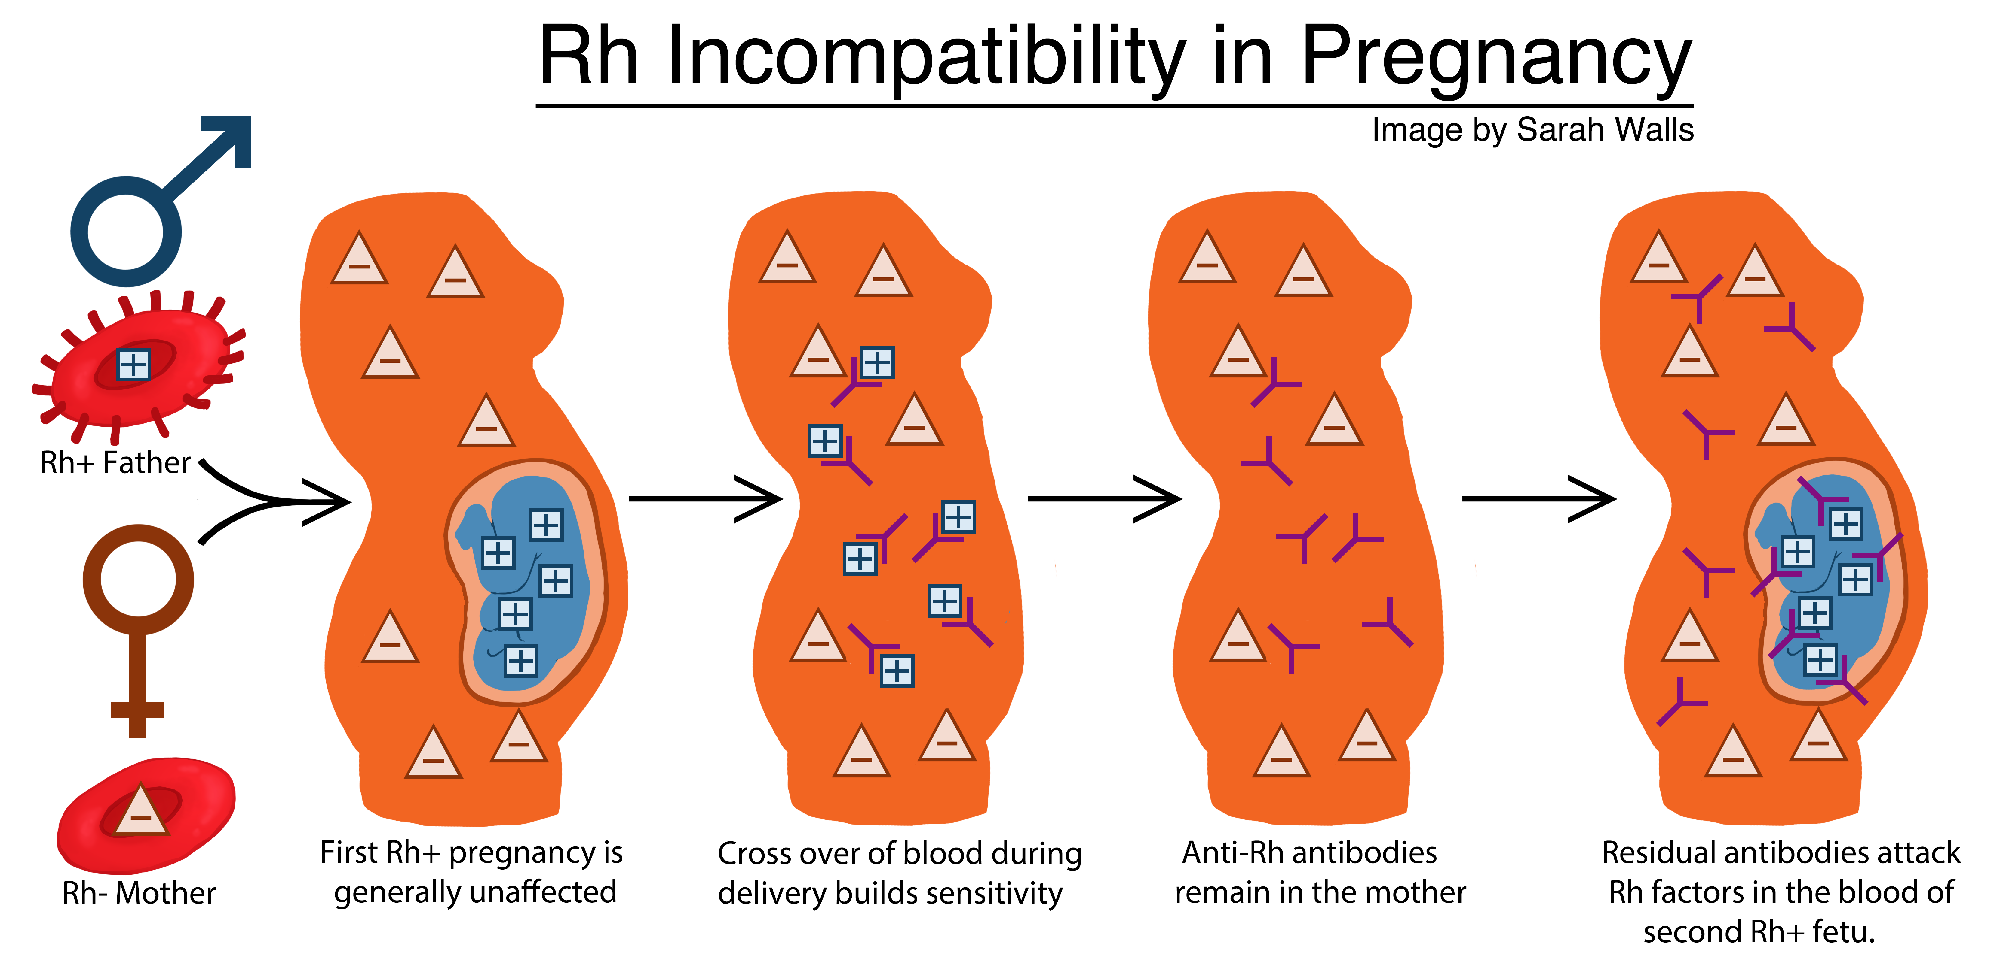
https://embryo.asu.edu/pages/rh-incompatibility-pregnancy

Slide 17
VIRTUAL BLOOD TYPING
https://educationalgames.nobelprize.org/educational/medicine/bloodtypinggame/gamev3/index.html
https://www.sciencefromscientists.org/game/bloodtype.html

Slide 18
Thank you!

